Slide 1
DYNAMIC RESOURCE ASSIGNMENT AND MIGRATION FOR EFFECTIVE CLOUD UTILIZATION
BY
GUIDE : Kavitha Subramani
BATCH NO: 15
TEAM MEMBERS:
AMRUTHA R (211417104014)
JAYASHRI M G (211417104091)
KAVITHA E (211417104114)

Slide 2
ABSTRACT
In the Existing system, The infrastructure resources in distributed green cloud data centers (DGCDCs) are shared by multiple heterogeneous applications to provide flexible services to global users in a high-performance and low-cost way. In the Proposed system, task scheduling and resource optimization (STSRO) method to minimize the total cost of their provider by cost-effectively scheduling all arriving tasks of heterogeneous applications to meet tasks’ delay-bound constraints. In the Modification Process, We deploy three types of systems. 1. Hot Machines can handle the current job. 2. Warm Machines are kept idle state until job is assigned. We deploy three Virtual servers for every machine. 1st Job is assigned to the Hot machine 1st Virtual machine and same way following jobs are assigned to other VMs. Now jobs are assigned to the Warm machines once all the VMs of Hot category have occupied with the jobs. Automatic migration of job is implemented, so as to transfer the load to the Hot VM from Warm VM once it has completed the job. 3. Cold Machine start to perform its job when all servers in hot and warm machines are filled with jobs already. We also implemented cache mechanism.

Slide 3
INTRODUCTION:
Cloud computing is the on-demand availability of computer system resources, especially data storage and computing power, without direct active management by the user .
There are three types of service models.
1.SaaS
2.IaaS
3.PaaS .
Now we are using IaaS (Infrastructure as a service). Infrastructure as a service are online services that provide high-level APIs used to dereference various low-level details of underlying network infrastructure like physical computing resources, location, data partitioning, scaling, security, backup etc.
Green networking is the practice of selecting energy-efficient networking technologies and products, and minimizing resource use whenever possible.

Slide 4
S NO | TITLE | YEAR | AUTHOR | INFERENCE | DRAWBACK
1 | Truthful Greedy Mechanisms for Dynamic Virtual Machine Provisioning and Allocation in Clouds | IEEE Transactio-ns on Parallel and Distributed Systems ( Volume: 26, Issue: 2, Feb. 2015) | Mahyar Movahed Nejad; Lena Mashayekhy; Daniel Grosu | The cloud provider provisions VMs based on the requests of the winning users and determines their payments. We show that the users do not have incentives to manipulate the system by lying about their requested bundles of VM instances and their valuations. Our proposed mechanisms achieve promising results in terms of revenue for the cloud provider. | it is more difficult to find an optimum provisioning decision under different server operational costs. It has a more power consumption

Slide 5
S NO | TITLE | YEAR | AUTHOR | INFERENCE | DRAWBACK
2 | An Online Auction Framework for Dynamic Resource Provisioning in Cloud Computing | IEEE/ACM Transactions on Networking ( Volume: 24, Issue: 4, Aug. 2016) | Weijie Shi; Linquan Zhang; Chuan Wu; Zongpeng Li; Francis C. M. Lau | It represents the first online combinatorial auction designed for the cloud computing paradigm, which is general and expressive enough to both: 1) Optimize system efficiency instead of an isolated time point; 2) Model dynamic provisioning heterogeneous VM types in practice. We also propose two extensions: 1) a binary search algorithm that improves the average-case performance and improvement to the online auction framework when a minimum budget is guaranteed. | The number of instances of each VM type is not predefined. Unlimited storage resources are used.

Slide 6
S NO | TITLE | YEAR | AUTHOR | INFERENCE | DRAWBACK
3 | Multi-Resource Fair Allocation in Heterogeneous Cloud Computing Systems | Published in: IEEE Transactions on Parallel and Distributed Systems ( Volume: 26, Issue: 10, Oct. 1 2015) | Wei Wang; Ben Liang; Baochun Li | Multi-resource allocation problem in cloud computing systems is constructed from a large number of heterogeneous servers, representing resources such as processing, memory, and storage. We design a multi-resource DRFH, that generalizing the notion of Dominant Resource Fairness from a single server to multiple heterogeneous servers. | In this paper, NP hard problem method are used. So it takes time for non deterministic machine is bounded by some polynomial function.

Slide 7
S NO | TITLE | YEAR | AUTHOR | INFERENCE | DRAWBACK
4 | Priority Based Dynamic resource allocation in Cloud Computing | 2012 , 1st IEEE international conference on communications in china (ICCC) | C . S . Pawar and R . B .Wagh | Resource provision is done by considering the Service Level Agreements (SLA) and with the help of parallel processing. Recent work considers various strategies with single SLA parameter. In this paper we propose an algorithm which considered Preemptable task execution and multiple SLA parameters such as memory, network bandwidth, and required CPU time. | In contention situation , the results shows PBSA perform better than CMMS in resource .

Slide 8
S NO | TITLE | YEAR | AUTHOR | INFERENCE | DRAWBACK
5 | Node capability aware resource provisioning in a heterogeneous cloud | 2012 , 1st IEEE International conference on communications in china (ICSS) | Wei-Tsung Su and Sun-Ming Wu | In this paper, the optimization problem, called Node Capability-aware Provisioning Problem (NCPP), is first formulated as a mathematical model. The purpose of NCPP is to minimize the job execution time which is influenced by node capability. Moreover, the node Capability-Aware Resource Provisioner (CARP) is proposed based on Apache Hadoop to show its feasibility to solve NCPP in a systematic way. | The algorithms in coarse-grained and fine-grained resource provisioning steps will be developed for NCPP , But these algorithms are not used.

Slide 9
PROBLEM STATEMENT
The main concept of our project is to reduce the space usage where we store data in cloud that needs more money.
By minimizing the space, we can reduce the cost and we have also have another benefit that we can implement green computing method in our project.
That is while processing to store data we run all systems that are connected to cloud which consumes more power; but using our project we can control the running systems so that power consumption will be reduced.

Slide 10
TECHNOLOGY STACK
Hardware Requirements
Processor : Core i3/i5/i7
RAM : 2-4GB
HDD : 500 GB
Software Requirements
Operating system : Windows 7/8
Front End : Java-JDK1.7
Back End : MYSQL
Cloud : DropBox

Slide 11
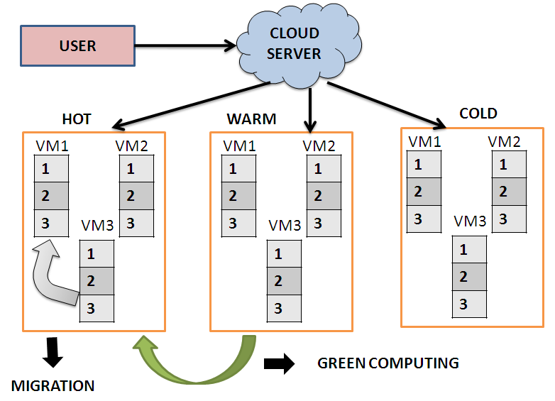
ARCHITECTURE DIAGRAM

Slide 12
EXPLANATION
We deploy two types of systems.
1. Hot Machines can handle the current job.
2. Warm Machines are kept idle state until job is assigned.
We deploy three Virtual servers for every machine. 1st Job is assigned to the Hot machine 1st Virtual machine and same way following jobs are assigned to other VMs.
Now jobs are assigned to the Warm machines once all the VMs of Hot category have occupied with the jobs. Automatic migration of job is implemented, so as to transfer the load to the Hot VM from Warm VM once it has completed the job.
We also implemented cache mechanism.

Slide 13
SYSTEM DESIGN – USE CASE

Slide 14
SYSTEM DESIGN – SEQUENCE

Slide 15
SYSTEM DESIGN – COLLABORATION

Slide 16
SYSTEM DESIGN – ACTIVITY

Slide 17
SYSTEM DESIGN – CLASS

Slide 18
MODULES
User registration
Cloud Server Deployment
Intermediate Server Deployment
Green Computing Setup
Migration of Virtual Server
Cache Server Implementation

Slide 19
USER REGISTRATION
In this module we are going to create a User application by which the User is allowed to access the data from the Server of the Cloud Service Provider.
Here first the User wants to create an account and then only they are allowed to access the Network.
Once the User creates an account, they are to login into their account and request the Job from the Cloud Service Provider.
Based on the User’s request, the Cloud Service Provider will process the User requested Job and respond to them. All the User details will be stored in the Database of the Cloud Service Provider.
In this Project, we will design the User Interface Frame to Communicate with the Cloud Server through Network Coding using the programming Languages like Java/ .Net. By sending the request to Cloud Server Provider, the User can access the requested data if they authenticated by the Cloud Service Provider.

Slide 20
CLOUD SERVER DEPLOYMENT
Cloud Service Provider will contain the large amount of data in their Data Storage.
Also the Cloud Service provider will maintain the all the User information to authenticate the User when are login into their account.
The User information will be stored in the Database of the Cloud Service Provider. Also the Cloud Server will redirect the User requested job to the Resource Assigning Module to process the User requested Job.
The Request of all the Users will process by the Resource Assigning Module. To communicate with the Client and the with the other modules of the Cloud Network, the Cloud Server will establish connection between them.
For this Purpose we are going to create a User Interface Frame.
Also the Cloud Service Provider will send the User Job request to the Resource Assign Module in Fist in First out (FIFO) manner.

Slide 21
INTERMEDIATE SERVER DEPLOYMENT
By implementing Intermediate Server the Job Processing Scheme, we can effectively process the User Requested Job and efficiently maintains the Resources of the Cloud Server. So that we can save the Energy of the Resources when they are not process the Job

Slide 22
GREEN COMPUTING SETUP
Green computing is the term used to denote efficient use of resources in computing. It Is also known as Green IT.
In this Module, we will Process the User requested Job. The User requested Job will redirect to the RAM of the Cloud Server.
The RAM will contain three Types of the Physical Servers. 1. HOT Server. WARM Server and COLD Server.
These Physical Servers will contain ‘n’ number of virtual Server to process the User requested Job. So that the Job can be efficiently processed.

Slide 23
MIGRATION OF VIRTUAL SERVER
In this module we create the migration server, main use of migration to migrate the job form on virtual serve to another server, so that the energy can be reduce and work load of the server is balanced, by using the Migration we can shift the process from one VM to anther VM without loss of data.

Slide 24
CACHE SERVER IMPLEMENTATION
As a modification in this Project, we are creating a Cache Memory in the User requested job will be stored for the period time.
If the another User requests the same Job to the Server of the Cloud Service Provider (CSP), the Server will check in the Cache Memory first .
So that we can reduce the Job Processing Time. If the request Data is presented, then the Server will provide the Data to the User immediately.
If the request Data is not in the Cache Memory, then the Server process the User requested Job by transferring it to the RAM.

Slide 25
ALGORITHM
RESOURCE MIGRATION ALGORITHM
Using this Algorithm, Once the job is allotted to a particular Server, assuming that this current job proposing server has completed half of the work, by the time the another already running server has completed the running job, then this running job will be dynamically moved to that current running server so that the job is migrated dynamically.

Slide 26
TESTING PROCESS
USER LOGIN:
S.NO | ACTION | INPUT | EXPECTED OUTPUT | ACTUAL OUTPUT | TEST RESULTS
1 | (REGISTRATION PAGE)Enter valid User name, Password, | User Name: XXXXXXX Password: ******* | “Registered Successfully” | “Registered Successfully” | PASSED
2 | Compare (USER LOGIN PAGE) Enter valid User Name and Password with registered field | User Name: XXXXXXX Password: ******* | It redirects to the source file | It redirects to the source file | PASSED
3 | Compare (USER LOGIN PAGE) Enter valid User Name and Password with registered field | User Name: XXXXXyyy Password: ******* | Invalid User Name and Password | Invalid User Name and Password | PASSED

Slide 27
FILE UPLOADING TO PHYSICAL SERVER:
S .NO | ACTION | INPUT | EXPECTED OUTPUT | ACTUAL OUTPUT | TEST RESULT
1 | ( D directory) Files are uploaded to the physical server | (AVAILABLE FILE FORMATS: Text files, image files, MS word files, pdf files .)Pdf files are uploaded to the physical server | “XXXXX.pdf” file download is completed | “XXXXX.pdf” file download is completed | PASSED
2 | (D directory) Files are uploaded to the physical server | (AVAILABLE FILE FORMATS: Text files, image files, MS word files, pdf files .) text files are uploaded to the physical server | “XXXXXXX.txt” file download is completed | “XXXXXXX.txt” file download is completed | PASSED

Slide 28
MIGRATION PROCESS:
S.NO | ACTION | INPUT | EXPECTED OUTPUT | ACTUAL OUTPUT | RESULTS
1 | During Files are running in the physical server | Pdf files are uploaded to the physical server | if the files in virtual machine 1 is completed . the job from another vm will migrated automatically | Automatically file migration process should be done | Success
FILES UPLOADING IN DROPBOX:
S .NO | ACTION | INPUT | EXPECTED OUTPUT | ACTUAL OUTPUT | TEST RESULT
1 | ( Download files directory) Files are uploaded to the physical server | (AVAILABLE FILE FORMATS: Text files, image files, MS word files, pdf files .) pdf files are uploaded to the physical server | “XXXXX.pdf” file download is completed and this files are uploaded in Drop box | “XXXXX.pdf” file download is completed and this files are visible in Drop box | Success

Slide 29
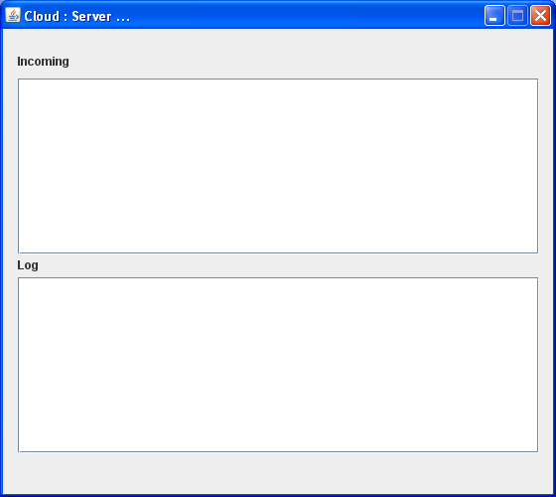
Cloud server

Slide 30
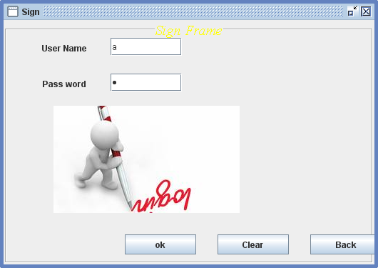
Sign in

Slide 31
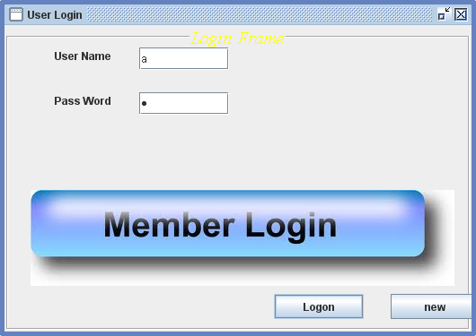
User login

Slide 32
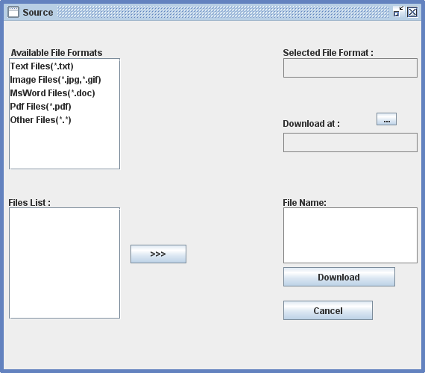
SOURCES

Slide 33
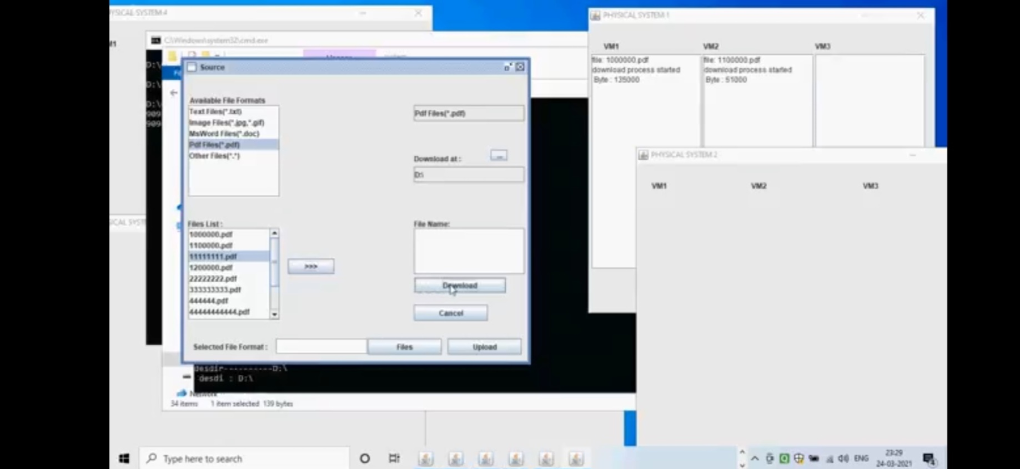
CLOUD SERVER DEPLOYMENT

Slide 34
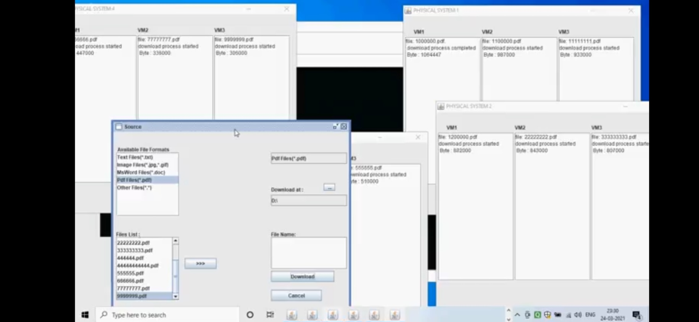
MIGRATION PROCESS

Slide 35
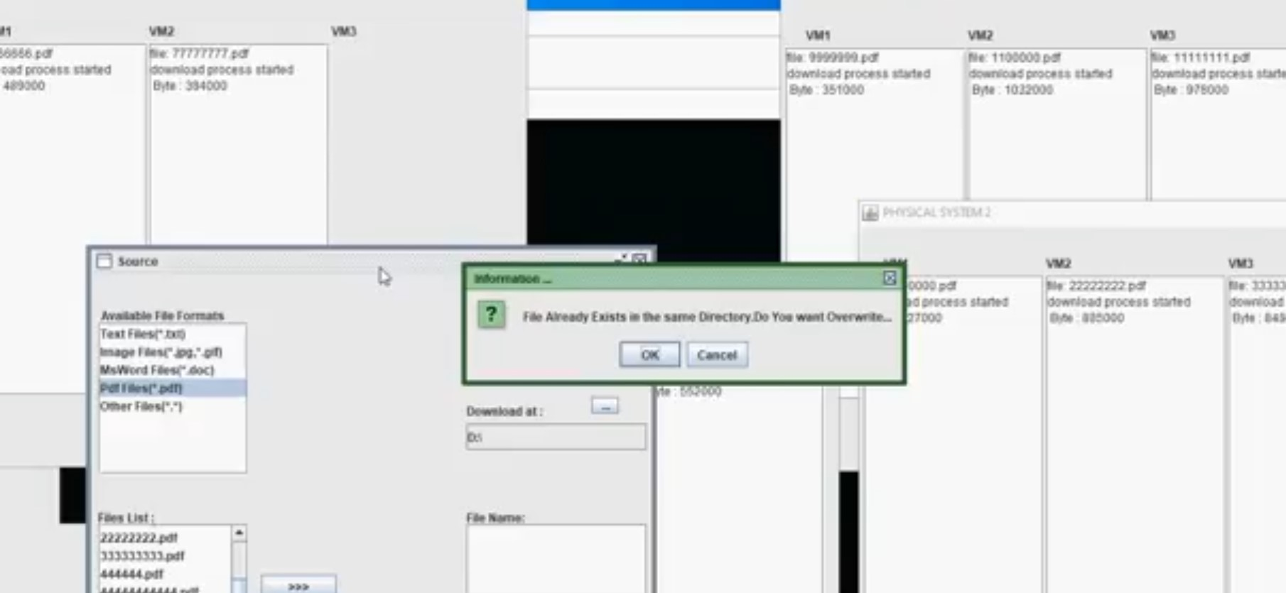

Slide 36
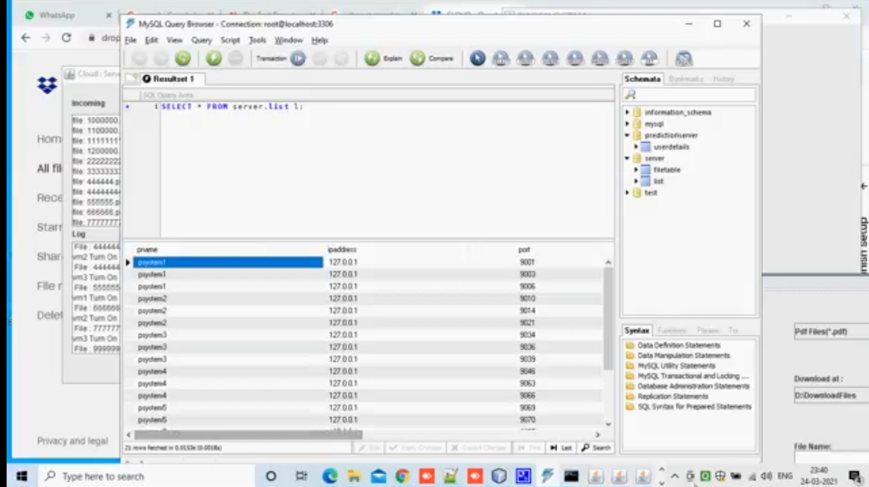
OUTPUT OF THE PROCESS

Slide 37
CONCLUSION
From the above discussions, we conclude that using our paper concept we can avoid wastage of power which helps us to implement green computing technology.
The same also helps us to save time and avoiding blockage. In disseminated registering development, we are using IAAS (Infrastructure as a service).
It suggests data storing. Also advantages like decreasing heat liberation once the structure is latent, life time structure is extended, holding up time is reduced, high throughput level using green frameworks organization.
Green frameworks organization is a demonstration of picking energy – capable frameworks organization progressions and things, and restricting resource use whenever possible.
The overall advantage of our paper is to fulfill green computing concept and it is achieved successfully

Slide 38
REFERENCE
[1] “Amazon ec2 instances, https://aws.amazon.com/ec2/instance-types/,” March 2017.
[2] “Microsoft azure virtual machines, https://azure.microsoft.com/enus/services/virtual-machines/,” March 2017.
[3] E.-K. Byun, Y.-S. Kee, J.-S. Kim, and S. Maeng, “Cost optimized provisioning of elastic resources for application workflows,” Future Generation Computer Systems, vol. 27, no. 8, pp. 1011–1026, 2011.
[4] V. V. Vinothina, R. Sridaran, and P. Ganapathi, “A survey on resource allocation strategies in cloud computing,” International Journal of Advanced Computer Science and Applications (IJACSA), vol. 3, no. 6, 2012.
[5] S. Kim and Y. Kim, “Application-specific cloud provisioning model using job profiles analysis,” in High Performance Computing and Communication & 2012 IEEE 9th International Conference on Embedded Software and Systems (HPCC-ICESS), 2012 IEEE 14th International Conference on. IEEE, 2012, pp. 360–366.

Slide 39
REFERENCE
[6] W.-T. Su and S.-M. Wu, “Node capability aware resource provisioning in a heterogeneous cloud,” in 2012 1st IEEE International Conference on Communications in China (ICCC). IEEE, 2012, pp. 46–50.
[7] G. Le, K. Xu, and J. Song, “Dynamic resource provisioning and scheduling with deadline constraint in elastic cloud,” in 2013 International Conference on Service Sciences (ICSS). IEEE, 2013, pp. 113–117.
[8] Y. Guo, P. Lama, J. Rao, and X. Zhou, “V-cache: Towards flexible resource provisioning for multi-tier applications in iaas clouds,” in Parallel & Distributed Processing (IPDPS), 2013 IEEE 27th International Symposium on. IEEE, 2013, pp. 88–99.
[9] C. S. Pawar and R. B. Wagh, “Priority based dynamic resource allocation in cloud computing,” in Cloud and Services Computing (ISCOS), 2012 International Symposium on. IEEE, 2012, pp. 1–6.
[10] S. Zaman and D. Grosu, “Combinatorial auction-based mechanisms for vm provisioning and allocation in clouds,” in Cluster, Cloud and Grid Computing (CCGrid), 2012 12th IEEE/ACM International Symposium on. IEEE, 2012, pp. 729–734.
[11]Rehana Begam , Wei Wang , Dakai Zhu ,”TIMER-cloud:time sensitive VM provisioning in resource constrained clouds”,2020 , IEEE transactions on cloud computing.

